Slide 1
CS112: Introduction to Python programming
Week 8: Numpy

Slide 2
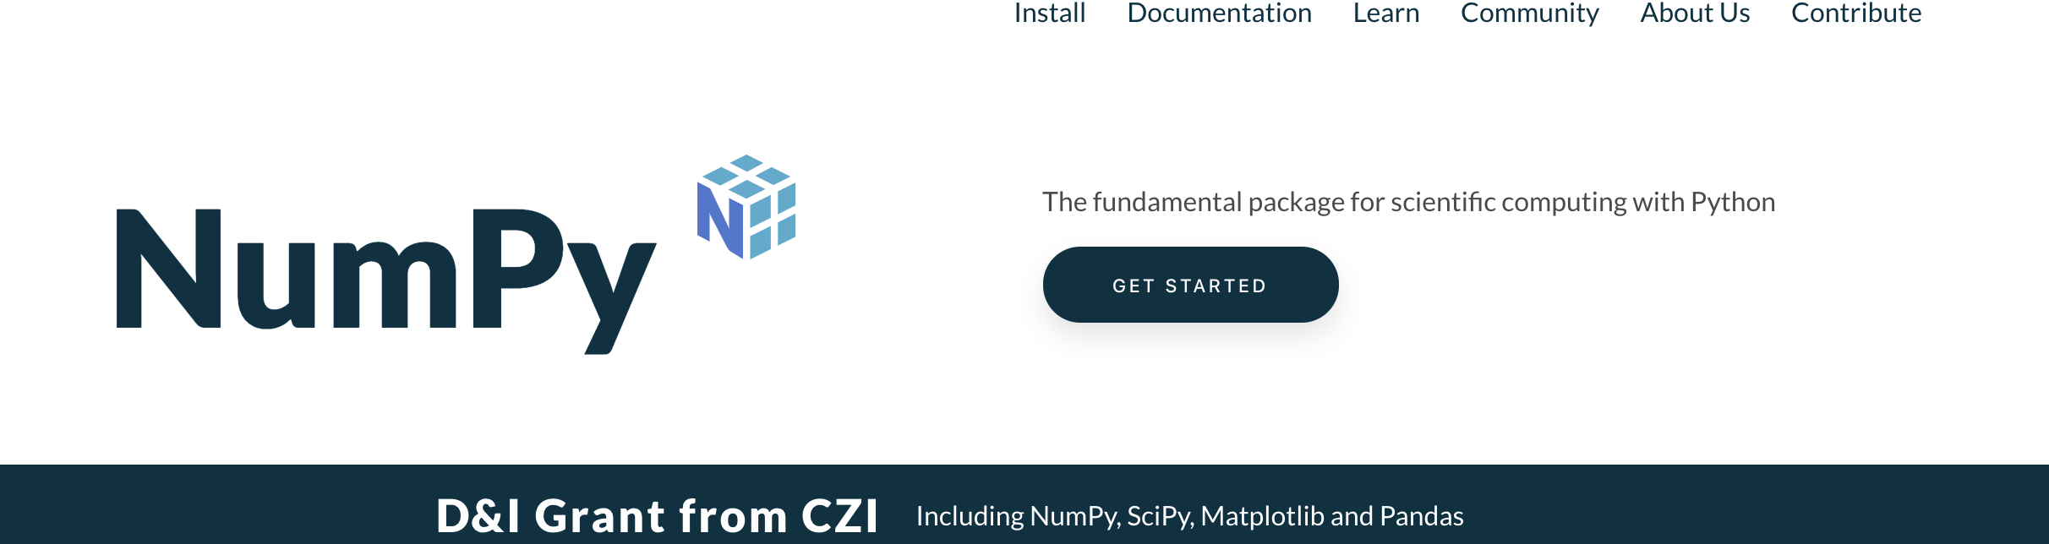
Numpy
https://numpy.org/
NumPy is a Python package. It stands for 'Numerical Python'. It is a library consisting of multidimensional array objects and a collection of routines for processing of array.
Numpy专用于数组计算，速度快，效率高,功能强大。

Slide 3
Numpy
NumPy is the fundamental package for scientific computing in Python.
It is a Python library that provides a multidimensional array object, various derived objects (such as masked arrays and matrices), and an assortment of routines for fast operations on arrays, including mathematical, logical, shape manipulation, sorting, selecting, I/O, discrete Fourier transforms, basic linear algebra, basic statistical operations, random simulation and much more.

Slide 4
Numpy
Install numpy
Using Anaconda
conda install numpy
To test whether NumPy module is properly installed, try to import it from Python:
import numpy as np

Slide 5
Numpy—Ndarray Object
The most important object defined in NumPy is an N-dimensional array type called ndarray. It describes the collection of items of the same type. Items in the collection can be accessed using a zero-based index.

Slide 6
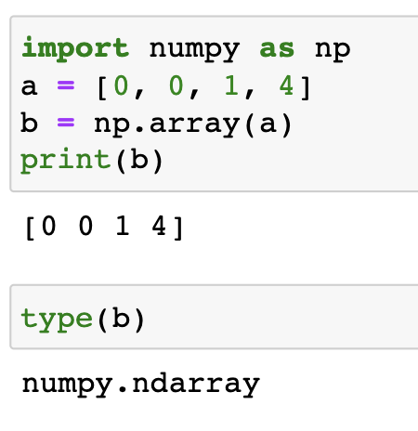
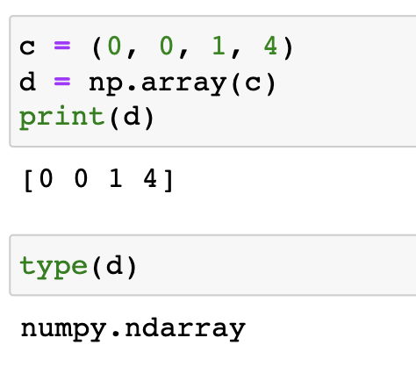
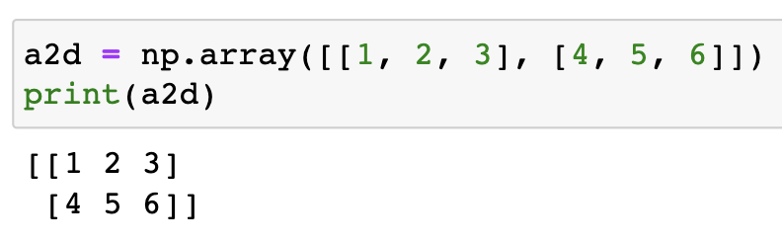
Numpy—Ndarray Object
Create an ndarray:
numpy.array(object), dtype)
Object: can be a list or tuple or nested list
dtype : Desired data type of array, optional

Slide 7
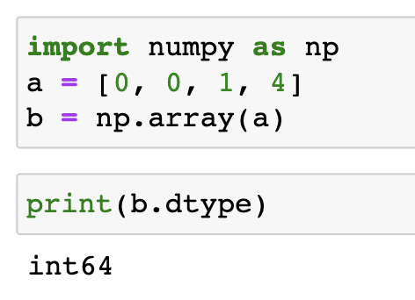
NumPy data types
NumPy has some extra data types, and refer to data types with one character
i - integer
b - boolean
u - unsigned integer
f - float
c - complex float
m - timedelta
M - datetime
O - object
S - string
U - unicode string
V - fixed chunk of memory for other type ( void )
Check data type of an existing array
arr.dtype

Slide 8
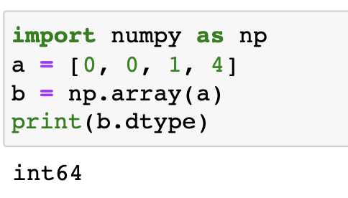
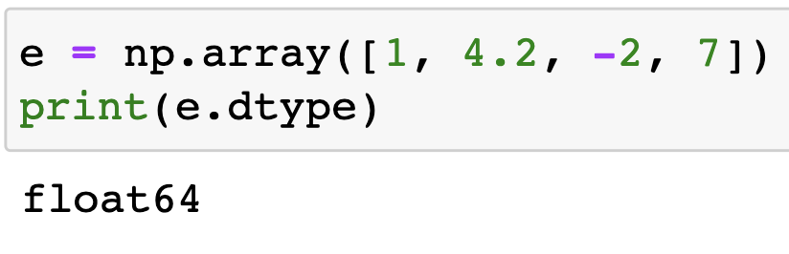
Numpy—Ndarray Object
b is integer arrays, as it is created from a list of integers
e is a floating point array even though only one of the elements of the list from which it was made was a floating point number
The array function automatically promotes all the numbers to the type of the most general entry in the list

Slide 9
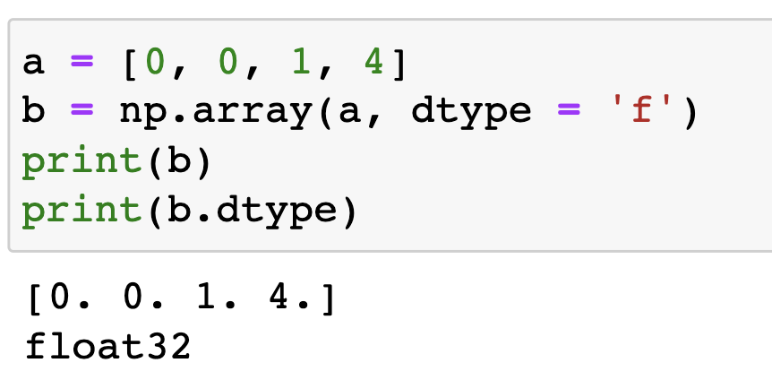
Numpy—Ndarray Object
numpy.array(object), dtype)
Object: can be a list or tuple or nested list
dtype : Desired data type of array, optional

Slide 10
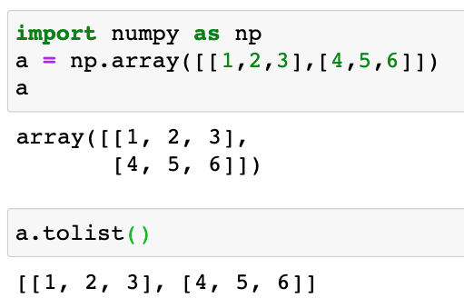
Numpy—Ndarray Object
ndarray to list array.tolist()

Slide 11
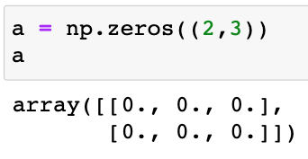
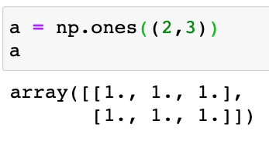
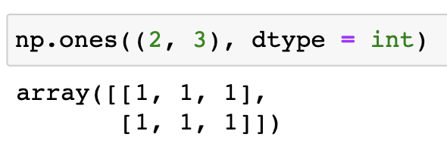
Array placeholder content
Using the NumPy zeros and ones function to create arrays where all the elements are either zeros or ones
They each take one mandatory argument, the number of elements in the array, and one optional argument that specifies the data type of the array. If unspecified, the data type is a float

Slide 12
Array placeholder content
>>> np.full((2,2),2)
array([[2, 2],
[2, 2])
>>> np.eye(2,3)
array([[1., 0., 0.],
[0., 1., 0.]])
>>> np.identity(2)
array([[1., 0.],
[0., 1.]])
>>> np.random.random((2,2))
array([[0.6, 0.4],
[0.1, 0.2]])
Return a new array of given shape and type, filled with `fill_value`.
Return a 2-D array with ones on the diagonal(对角线) and zeros elsewhere.
Return the identity array.
The identity array is a square array with ones on the main diagonal.
Return random floats in the half-open interval [0.0, 1.0).

Slide 13
NumPy linspace and logspace functions
The linspace function creates an array of N evenly spaced points between a starting point and an ending point. The form of the function is linspace(start, stop, N). If the third argument N is omitted, then N=50:
>>> np.linspace(0, 10, 5)
array([ 0. , 2.5, 5. , 7.5, 10. ])

Slide 14
NumPy linspace and logspace functions
The logspace function produces evenly spaced points on a logarithmically spaced scale. The form of the function is logspace(start, stop, N). The start and stop refer to a power of 10, i.e., the array starts at 10^{start} and ends at 10^{stop}:
>>> np.set_printoptions(precision=1)
>>> np.logspace(0, 3, 3)
array([ 1. , 31.6, 1000. ])

Slide 15
NumPy arange function
The arange function return evenly spaced values within a given interval. numpy.arange(start, stop, step)
In general, arange produces an integer array if the arguments are all integers; if any one of the arguments is a float, the generated array would be a float
>>> np.arange(0, 10, 2)
array([0, 2, 4, 6, 8])
>>> np.arange(0., 10, 2)
array([0., 2., 4., 6., 8.])
>>> np.arange(0, 10, 1.5)
array([0. , 1.5, 3. , 4.5, 6. , 7.5, 9. ])

Slide 16
NumPy arange function
The arange function return evenly spaced values within a given interval. numpy.arange(start, stop, step)
In general, arange produces an integer array if the arguments are all integers; if any one of the arguments is a float, the generated array would be a float
>>> np.arange(0, 10, 2)
array([0, 2, 4, 6, 8])
>>> np.arange(0., 10, 2)
array([0., 2., 4., 6., 8.])
>>> np.arange(0, 10, 1.5)
array([0. , 1.5, 3. , 4.5, 6. , 7.5, 9. ])
For integer arguments the function is roughly equivalent to the Python built-in range, but returns an ndarray rather than a range instance.
When using a non-integer step, such as 0.1, it is often better to use numpy.linspace.

Slide 17
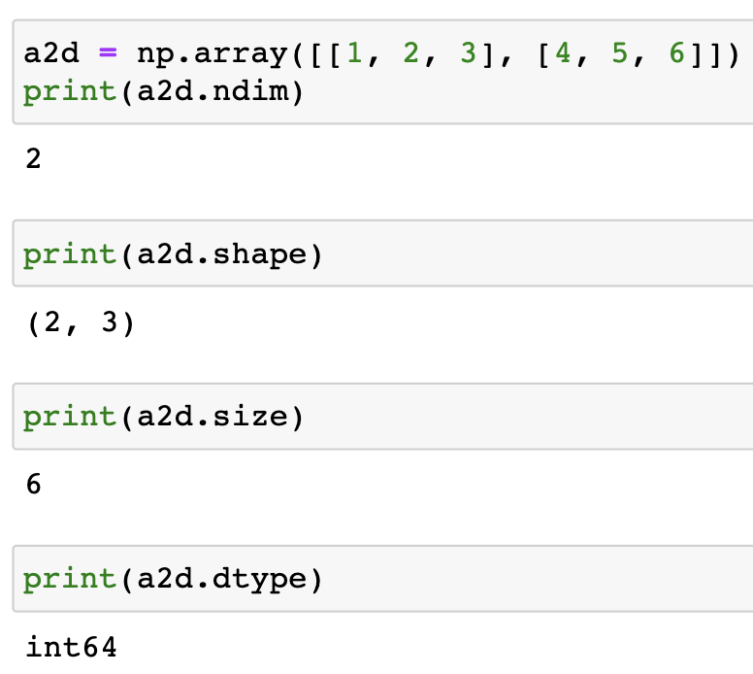
Array attributes
ndarray.ndim
returns the number of array dimensions
ndarray.shape
returns a tuple consisting of array dimensions. It can also be used to resize the array.
For more introduction on array attributes and methods:
https://numpy.org/doc/stable/reference/arrays.ndarray.html

Slide 18
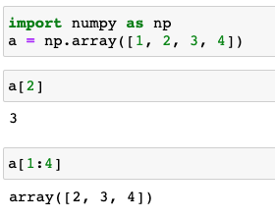
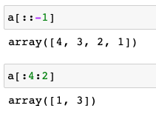

Array Indexing & Slicing
Similar to Python lists, numpy arrays can be sliced.
One-dimensional arrays can be indexed and sliced the same way as strings and lists, i.e., array indexes are 0-based:

Slide 19
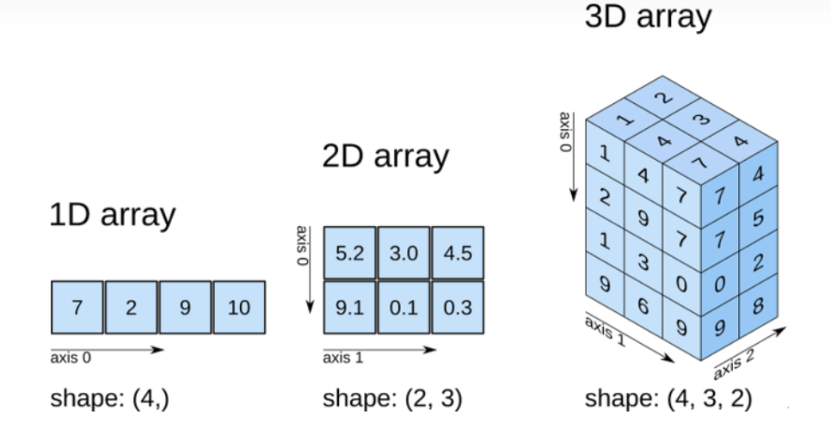
NumPy中的轴(axis)、的含义

Slide 20
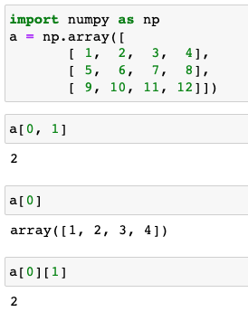
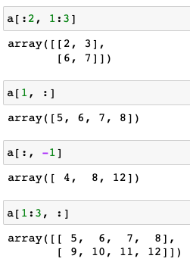
Array Indexing & Slicing
Multi-dimensional arrays can be indexed and sliced per axis:

Slide 21
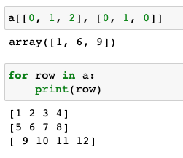
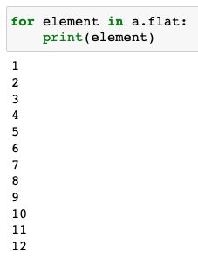
Array Indexing & Slicing
Multi-dimensional arrays can be indexed and sliced per axis:

Slide 22
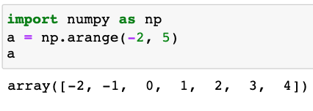
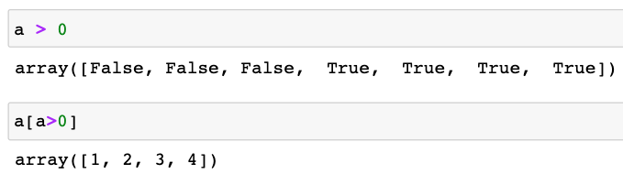
Array Indexing & Slicing
Boolean indexing

Slide 23
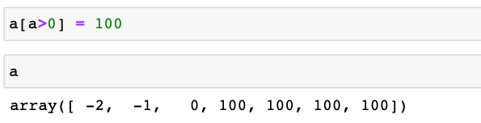
Array Indexing & Slicing
Boolean indexing

Slide 24
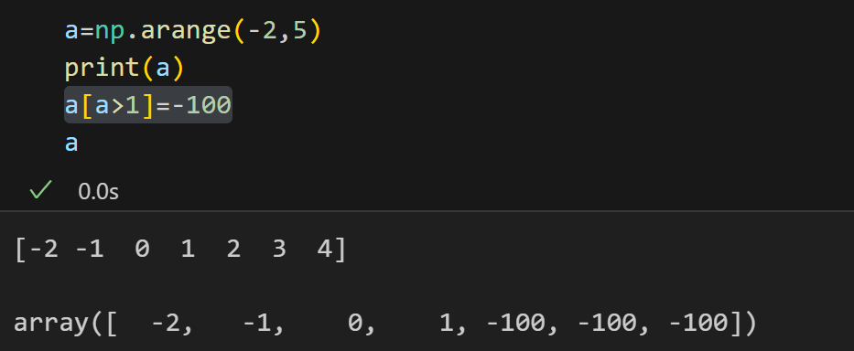
Array Indexing & Slicing
Boolean indexing

Slide 25
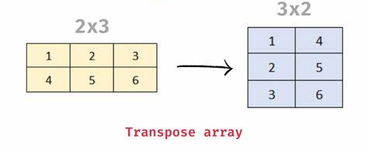
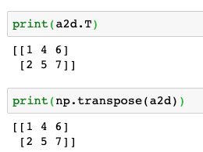
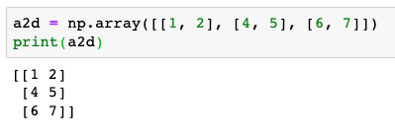
Array transpose（转置）
array.T
numpy.transpose()

Slide 26
Array adding elements
numpy.append(arr, values, axis=None)
Append values to the end of an array.
arr: array_like. Values are appended to a copy of this array.
values: array_like. These values are appended to a copy of arr. It must be of the correct shape (the same shape as arr, excluding axis).
axis: int, optional. The axis along which values are appended. If axis is not given, both arr and values are flattened before use.
Returns:
A copy of arr with values appended to axis. Note that append does not occur in-place: a new array is allocated and filled. If axis is None, out is a flattened array.

Slide 27
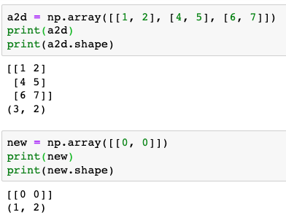
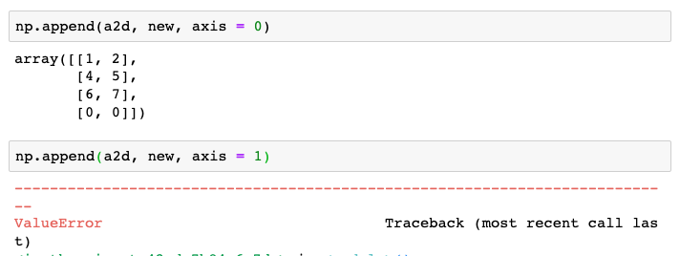
Array adding elements
numpy.append(arr, values, axis=None)
Append values to the end of an array.

Slide 28

Array adding elements
numpy.append(arr, values, axis=None)
Append values to the end of an array.
If axis is not given, both arr and values are flattened before use.

Slide 29
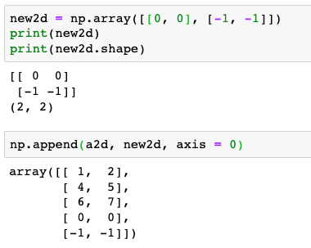
Array adding elements
numpy.append(arr, values, axis=None)
Append values to the end of an array.

Slide 30
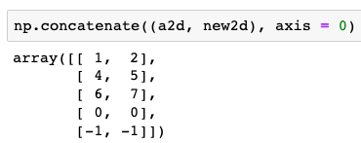
Array adding elements
numpy.concatenate((a1, a2, ...), axis=0)
Join a sequence of arrays along an existing axis.

Slide 31
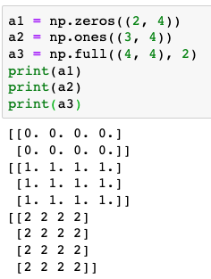
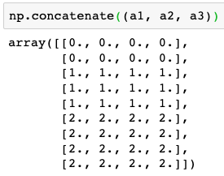
Array adding elements
numpy.concatenate((a1, a2, ...), axis=0)
Join a sequence of arrays along an existing axis.

Slide 32
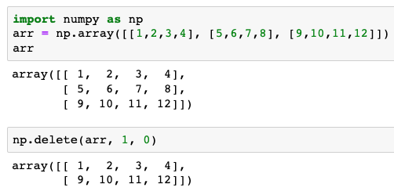
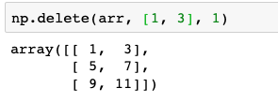

Array deleting elements
numpy.delete(arr, obj, axis=None)
Return a new array with sub-arrays along an axis deleted.
If axis is None, obj is applied to the flattened array.

Slide 33
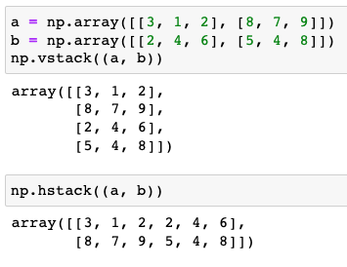
Array Stacking & splitting
np.vstack(tup):
Stack arrays in sequence vertically (row wise).
tup: sequence of ndarrays
np.hstack(tup):
Stack arrays in sequence horizontally (column wise).
tup: sequence of ndarrays

Slide 34
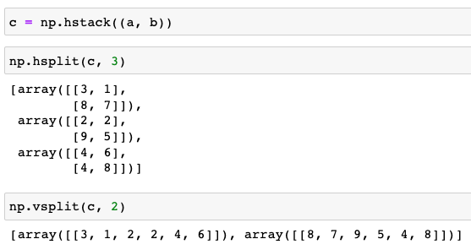
Array Stacking & splitting
numpy.vsplit(ary, indices_or_sections)
Split an array into multiple sub-arrays vertically (row-wise).
numpy.hsplit(ary, indices_or_sections)
Split an array into multiple sub-arrays horizontally (column-wise).

Slide 35
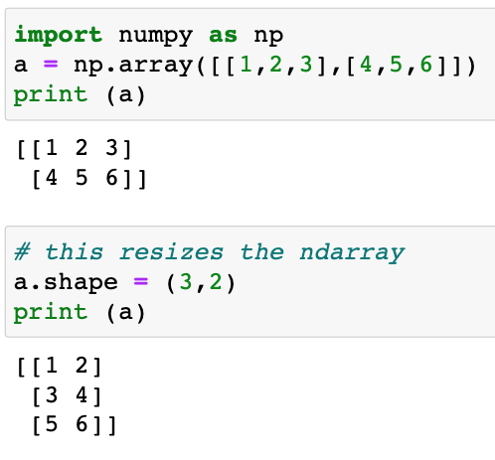
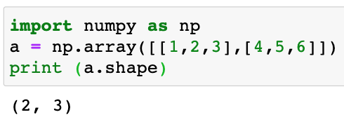
Shape & reshape
ndarray.shape
This array attribute returns a tuple consisting of array dimensions. It can also be used to reshape the array.

Slide 36
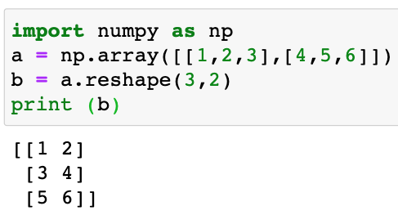
Shape & reshape
NumPy also provides a reshape() function to resize an array.

Slide 37

Shape & reshape
numpy.ravel()
Return a flattened array.

Slide 38
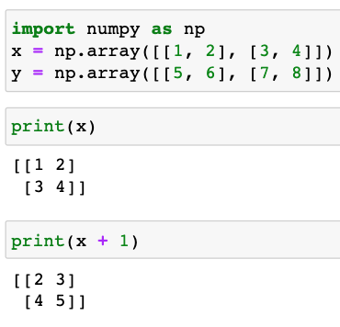
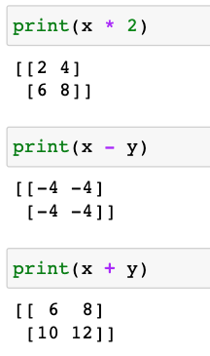
Array Math
Basic mathematical functions operate elementwise on arrays, and are available both as operator overloads and as functions in the numpy module:

Slide 39
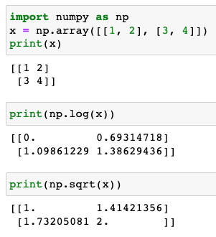
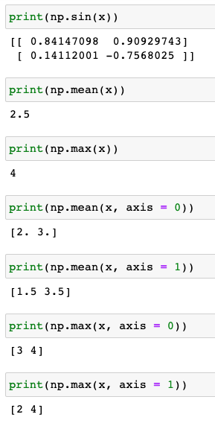
Array Math

Slide 40
Array Math
Basic mathematical functions operate elementwise on arrays, and are available both as operator overloads and as functions in the numpy module:
These operations with arrays are called vectorized 向量operations because the entire array, or “vector,” is processed as a unit.
Vectorized operations are much faster than processing each element of an array one by one.
Writing code that takes advantage of these kinds of vectorized operations is almost always preferred to other means of accomplishing the same task

Slide 41
Array & List
Lists are part of the core Python programming language; arrays are a part of the numerical computing package NumPy
The elements of a NumPy array must all be of the same type, whereas the elements of a Python list can be of completely different types
Arrays allow Boolean indexing; lists do not
NumPy arrays support “vectorized” operations like element-by-element addition and multiplication
Adding one or more additional elements to a NumPy array creates a new array and destroys the old one. Therefore, it can be very inefficient to build up large arrays by appending elements one by one. By contrast, elements can be added to a list without creating a whole new list

Slide 42
Broadcasting
The term broadcasting describes how NumPy treats arrays with different shapes during arithmetic operations:
>>> array_1 = np.ones([4, 5])
>>> array_2 = np.arange(5)
>>> array_1
array([[1., 1., 1., 1., 1.],
[1., 1., 1., 1., 1.],
[1., 1., 1., 1., 1.],
[1., 1., 1., 1., 1.]])
>>> array_2
array([0, 1, 2, 3, 4])
>>> array_1 + array_2
array([[1., 2., 3., 4., 5.],
[1., 2., 3., 4., 5.],
[1., 2., 3., 4., 5.],
[1., 2., 3., 4., 5.]])
Broadcasting allows NumPy functions to deal in a meaningful way with input arrays that do not have exactly the same shape
Subject to certain constraints, the smaller array is “broadcast” across the larger array so that they have compatible shapes
The original array is not affected

Slide 43
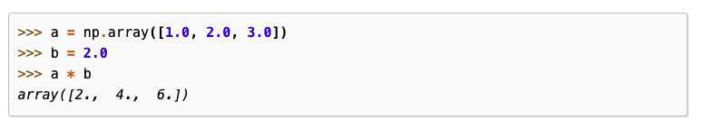
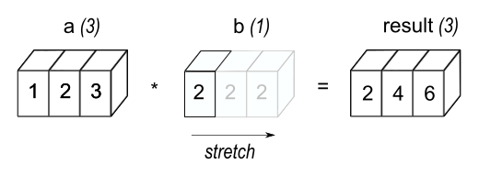
Broadcasting
In the simplest example of broadcasting, the scalar b is stretched to become an array of same shape as a so the shapes are compatible for element-by-element multiplication.

Slide 44
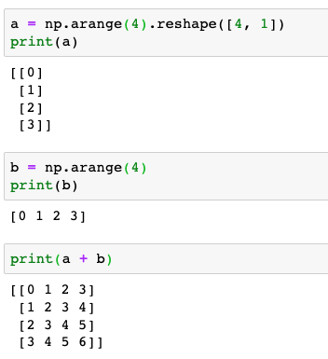
Broadcasting
0 | 0 | 0 | 0
1 | 1 | 1 | 1
2 | 2 | 2 | 2
3 | 3 | 3 | 3
+
0 | 1 | 2 | 3
0 | 1 | 2 | 3
0 | 1 | 2 | 3
0 | 1 | 2 | 3

Slide 45
Broadcasting
When operating on two arrays, NumPy compares their shapes element-wise. It starts with the trailing (i.e. rightmost) dimensions and works its way left. Two dimensions are compatible when
they are equal, or
one of them is 1
If these conditions are not met, a ValueError: operands could not be broadcast together exception is thrown, indicating that the arrays have incompatible shapes.
The size of the resulting array is the size that is not 1 along each axis of the inputs.

Slide 46
Broadcasting in arrays
Rule 1 → If two input arrays do not have the same number of dimensions, a “1” will repeatedly be padded to the shape of the smaller array on its left side by NumPy so both the arrays have the same number of dimensions
Rule 2 → If the shape of two input arrays does not match, then the array with a shape of “1” along a particular dimension is stretched by NumPy to match the shape of the array having the largest shape along that dimension. The value of the array element is assumed to be the same along that dimension for the “broadcast” array. After application of the broadcasting rules, the sizes of all arrays must match
Rule 3 → If the above two rules are not met, a ValueError exception is thrown, indicating that the arrays have incompatible shapes

Slide 47
Broadcasting in arrays
>>> array_1 = np.random.random([2, 3])
>>> array_2 = np.ones(5)
>>> array_1.shape
(2, 3)
>>> array_2.shape
(5,)
>>> array_1 + array_2
Traceback (most recent call last):
File "<stdin>", line 1, in <module>
ValueError: operands could not be broadcast together with shapes (2,3) (5,)

Slide 48
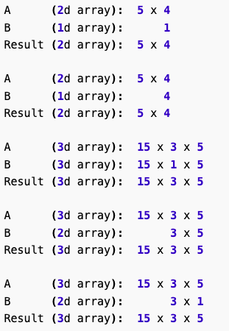
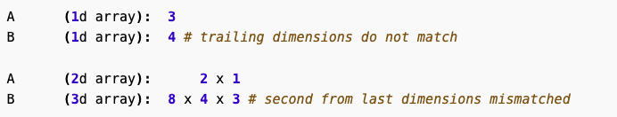
Broadcasting
The size of the resulting array is the size that is not 1 along each axis of the inputs.
Broadcastable
Not broadcastable
Question:
A (2d array): 4 x 1
B (1d array): 4
What is the dimension of A * B?

Slide 49
NumPy Random
Random numbers are widely used in science and engineering computations
The basic idea of a random number generator is that it should be able to produce a sequence of numbers that are distributed according to some predetermined distribution functions
NumPy provides a number of such random number generators in its library numpy.random

Slide 50
NumPy Random
Random numbers are expected to be different from time to time
Generate a random integer from 0 to 100:
random.randint(low, high=None, size=None, dtype=int)
Return random integers from low (inclusive) to high (exclusive).
If high is None (the default), then results are from [0, low).
from numpy import random x = random.randint(100) print(x)
98
Generate a random float from 0 to 1:
random.rand(d0, d1, ..., dn)
Create an array of the given shape and populate it with random samples from a uniform distribution over [0, 1)
x = random.rand() print(x)
0.7895916740359221
https://www.w3schools.com/python/numpy

Slide 51
NumPy Random
Generate random arrays
random.randint(low, high=None, size=None, dtype=int)
Return random integers from low (inclusive) to high (exclusive).
If high is None (the default), then results are from [0, low).
from numpy import random x = random.randint(100, size=(3, 5)) print(x)
[[90 99 11 30 34]
[66 40 63 36 37]
[63 35 89 51 58]]
random.rand(d0, d1, ..., dn)
Create an array of the given shape and populate it with random samples from a uniform distribution over [0, 1)
x = random.rand(2, 2) print(x)
[[0.13273287 0.92268245]
[0.05374344 0.98251619]]
https://www.w3schools.com/python/numpy

Slide 52
NumPy Random
Generate Random Number From Array
from numpy import random x = random.choice([3, 5, 7, 9]) print(x)
The choice() function takes an array as a parameter and randomly returns one of the values.
Add a size parameter to specify the shape of the array.
3
x = random.choice([3, 5, 7, 9], size=(2, 2))
print(x)
[[5 5]
[3 3]]
https://www.w3schools.com/python/numpy

Slide 53
NumPy Random
Generate shuffling or permutation of arrays
from numpy import random import numpy as np arr = np.array([1, 2, 3, 4, 5]) random.shuffle(arr) print(arr)
The shuffle() method makes changes to the original array.
The permutation() method returns a re-arranged array (and leaves the original array un-changed).
[4 2 3 5 1]
print(random.permutation(arr))
[1 5 4 2 3]
https://www.w3schools.com/python/numpy

Slide 54
NumPy Random
Normal distribution
random.normal(loc=0.0, scale=1.0, size=None):
Draw random samples from a normal (Gaussian) distribution.
loc - (Mean) where the peak of the bell exists.
scale - (Standard Deviation) how flat the graph distribution should be.
size - The shape of the returned array.
from numpy import random x = random.normal(size=(2, 3)) print(x)
[[ 2.2799698 -1.51394603 2.07008094] [ 0.03266912 1.27996989 1.1790585 ]]
x = random.normal(loc=10, scale=2, size=(2, 3)) print(x)
[[13.19029955 10.19232563 11.56913201]
[10.96922729 10.10848335 7.53244539]]
https://www.w3schools.com/python/numpy

Slide 55
NumPy Random
Uniform distribution
random.uniform(low=0.0, high=1.0, size=None)
Draw samples from a uniform distribution.
low - lower bound - default 0 .0.
high - upper bound - default 1.0.
size - The shape of the returned array.
from numpy import random x = random.uniform(size=(2, 3)) print(x)
[[0.44566407 0.38663387 0.00408744]
[0.6377317 0.19637125 0.51735068]]
x = random.uniform(low=1, high=2, size=(2, 3)) print(x)
[[1.29679823 1.3713605 1.91737559]
[1.40184556 1.9386972 1.62989992]]
https://www.w3schools.com/python/numpy

Slide 56
NumPy Random--多种分布
random.binomial(n=10, p=0.5, size=10) # Binomial distribution
random.poisson(lam=2, size=10) # Poisson distribution
random.logistic(loc=1, scale=2, size=(2, 3)) # Logistic distribution
random.multinomial(n=3, pvals=[1/3, 1/3, 1/3]) # Multinomial dist.
random.exponential(scale=2, size=(2, 3)) # Exponential distribution
random.chisquare(df=2, size=(2, 3)) # Chi-square distribution
random.rayleigh(scale=2, size=(2, 3)) # Rayleigh distribution
random.pareto(a=2, size=(2, 3)) # Pareto distribution
random.zipf(a=2, size=(2, 3)) # Zipf distribution
https://www.w3schools.com/python/numpy

Slide 57
NumPy Set Operations
import numpy as np
arr = np.array([1, 1, 2, 3, 4, 5, 5]) x = np.unique(arr) print(x)
Unique
numpy.unique(ar, return_index=False, return_inverse=False,
return_counts=False, …)
[1 2 3 4 5]
x, index, counts= np.unique(arr, return_index=True, return_counts=True)
print(x)
print(index)
print(counts)
[1 2 3 4 5]
[0 2 3 4 5]
[2 1 1 1 2]
https://www.w3schools.com/python/numpy

Slide 58
NumPy Set Operations
arr1 = np.array([1, 2, 3, 4]) arr2 = np.array([3, 4, 5, 6]) newarr = np.union1d(arr1, arr2) print(newarr)
Union
[1 2 3 4 5 6]
https://www.w3schools.com/python/numpy

Slide 59
NumPy Set Operations
arr1 = np.array([1, 2, 3, 4]) arr2 = np.array([3, 4, 5, 6])
newarr = np.intersect1d(arr1, arr2) print(newarr)
Intersection
[3 4]
newarr = np.setdiff1d(arr1, arr2) print(newarr)
Difference
[1 2]
https://www.w3schools.com/python/numpy

Slide 60
NumPy Set Operations
arr1 = np.array([1, 2, 3, 4]) arr2 = np.array([3, 4, 5, 6])
newarr = np.setxor1d(arr1, arr2) print(newarr)
Symmetric difference
[1 2 5 6]
arr1 = np.array([1, 2, 3, 4]) arr2 = np.array([3, 4, 5, 6]) print(np.in1d(arr1, arr2))
Membership test
[False False True True]
https://www.w3schools.com/python/numpy

Slide 61
NumPy Searching Arrays
To search an array, use the where() method.
import numpy as np arr = np.array([1, 2, 3, 4, 5, 4, 4]) x = np.where(arr == 4) print(x)
(array([3, 5, 6]),)
arr = np.array([1, 2, 3, 4, 5, 6, 7, 8]) x = np.where(arr%2 == 0) print(x)
(array([1, 3, 5, 7]),)
https://www.w3schools.com/python/numpy

Slide 62
NumPy Searching Arrays
np.where(condition, x,y)
condition 成立時返回x,否則返回y
a=np.arange(10)
b=np.where(a,1,-1)
c=np.where(a>0,1,-1)
d=np.where(a>2,1,-1)

Slide 63
NumPy sort array
np.sort(a, axis, kind, order)
import numpy as np
a = np.array([[3,5,7],[9,6,1]])
#按列排序
b1=np.sort(a)
c=np.sort(a, axis = 0))
# 在 sort 函数中排序字段
dt = np.dtype([('name', 'S10'),('age', int)])
a = np.array([("raju",21),("anil",25),("ravi", 17), ("amar",27)], dtype = dt)
print (np.sort(a, order = 'name'))

Slide 64
NumPy Saving/Loading Data
genfromtxt (and the simpler loadtxt) will read in deliminated files.
import numpy as np
np.genfromtxt('./csv_file.csv')
csv_file.csv
array([nan, nan, nan])
1,2,3
4,5,6
7,8,9
np.genfromtxt('./csv_file.csv', delimiter=',')
array([[1., 2., 3.],
[4., 5., 6.],
[7., 8., 9.]])

Slide 65
NumPy Saving/Loading Data
Binary files have two notable advantages over text-based files: file size and read/write speeds
In NumPy, files can be accessed in binary format using numpy.save and numpy.load:
>>> import numpy as np
>>> data = np.ones((10, 10))
>>> np.save('test.npy', data)
>>> np.savetxt('test.txt', data)
>>> newdata = np.load('test.npy')

Slide 66
Summary
Numpy功能十分强大，与相关的包一起可以完成复杂的数学运算
https://zhuanlan.zhihu.com/p/378431886
基本操作 | 描述
np.array([1,2,3]) | 一维数组
np.array([(1,2,3),(4,5,6)]) | 二维数组
np.arrange(start,stop,step) | 等差数组(不包括stop)
数组占位符 | 描述
np.linspace(0,2,9) | 数组中添加等差的值
np.zeros((1,2)) | 创建全0数组
np.ones((1,2)) | 创建全1数组
np.empty((2,2)) | 创建空数组
np.random.random((5,5)) | 创建随机数数组

Slide 67
summary
数组属性
array.shape | 维度(行，列)
len(array) | 数组长度
array.ndim | 数组维度
array.size | 数组的元素数
array.dtype | 数据类型
array.astype(type) | 转换数组类型
type(array) | 显示数组类型

Slide 68
summary
数组操作 | 描述
np.append(a,b) | 增加数据到数组
np.resize((2,4)) | 调整数组的形状为(2,4)
np.delete(array.1,axis) | 从数组中删除数据项
数组操作 | 描述
np.transpose()/arrat.T | 矩阵转置
np.linalg.inv(matrix) | 求逆矩阵
数学计算 | 描述
np.add(a,b) | 矩阵a+矩阵b
np.substract(a,b) | 矩阵a减矩阵b
np.divide(a,b) | 矩阵a除矩阵b
...
np.mean(array)
np.std(array)

Slide 69
summary
切片和子集 | 描述
array[i] | 索引[i]处的一维数组
array[i,j] | 索引[i][j]处的二维数组
array[i<4] | 布尔索引
array[0:3] | 选择索引为0,1,2
array[0:3,1] | 选择索引为0,1,2行，第1列
array[:1] | 选择第0行数据项
array[1:2,:] | 选择第1行数据项
array[::-1] | 反转数组

